Slide 1

AdalegIT Final Project Presentation: Sales Lead Prediction
Yam Cooper, collecting data in the field
Data Analytics and Business Intelligence
Data Science and Machine Learning

Slide 2
Table of Contents
Project Brief
Analysis
Machine Learning
Conclusions

Slide 3


Project Brief: Sales Lead Prediction
Dataset: bank client records indicating leads for a credit card promotion campaign
Learning goals:
Process a dataset through the entire machine learning pipeline using python
Derive meaningful insights about the data through analysis
Create a ML model that can predict which client might be a lead
Motivation:
Assist the business in increasing its profit by enabling the marketing department to more accurately target clients that are most likely to buy, in turn reducing cost and turn-around time
Glean other insights that can help the business resell to more clients or get more leads
Project Brief
Machine Learning
Conclusions
Analysis

Slide 4

Dataset
Dataset features:
Account info:
Monthly account balance
Vintage (tenure)
Demographic info:
Gender
Age
Occupation
Region
Marketing-related info:
Acquisition channel
Account activity
Product indicated
Interest indicated (Are they a lead?)
Dataset is most likely in Rupees (Indian source)
Project Brief
Machine Learning
Conclusions
Analysis

Slide 5


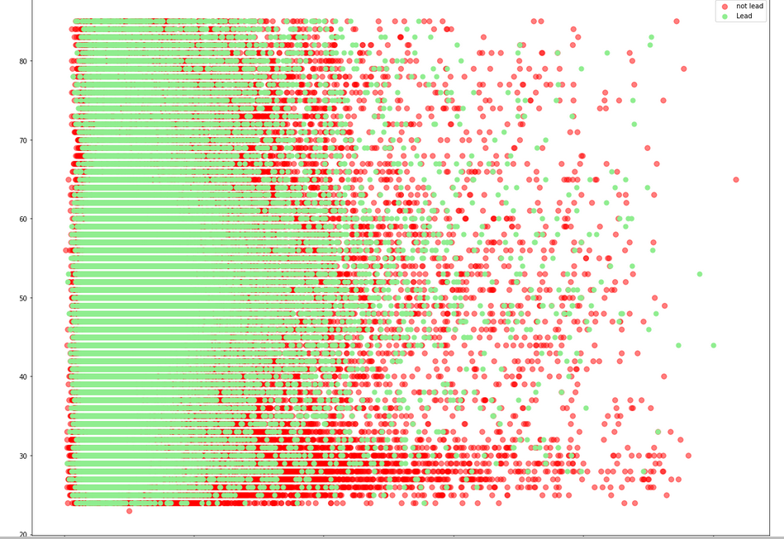
Power BI Analysis
Analysis
Over 250K client records
Various encoded columns (regions, channels) in India
Leads tend to have a higher average monthly account balance
Most leads are between 40 – 60 years old
The author, data-wrangling
Project Brief
Machine Learning
Conclusions
Analysis

Slide 6
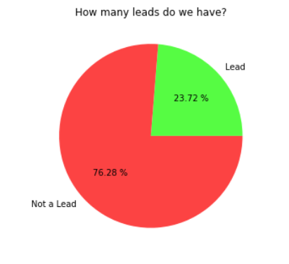
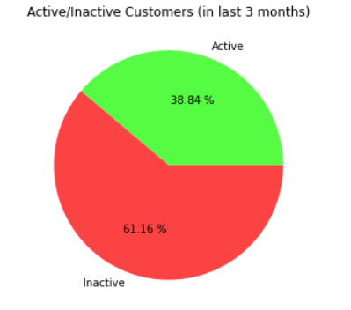
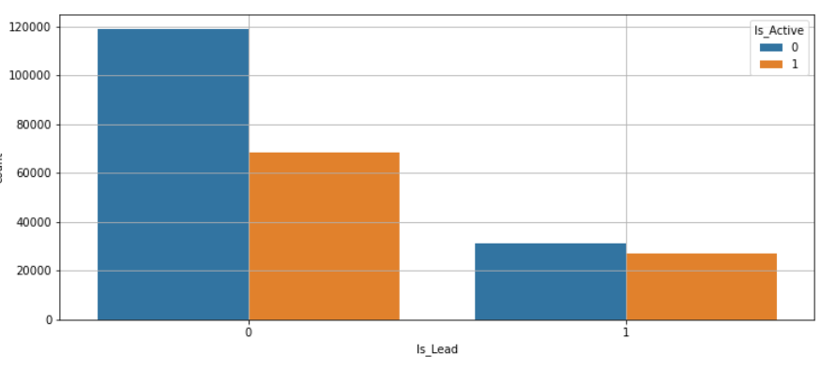
Analysis
Just under one quarter of the dataset represents actual leads (1 in 4 people)
Almost 60% of the clients have been inactive for the last 3 months
Leads could equally be active or inactive

Slide 7
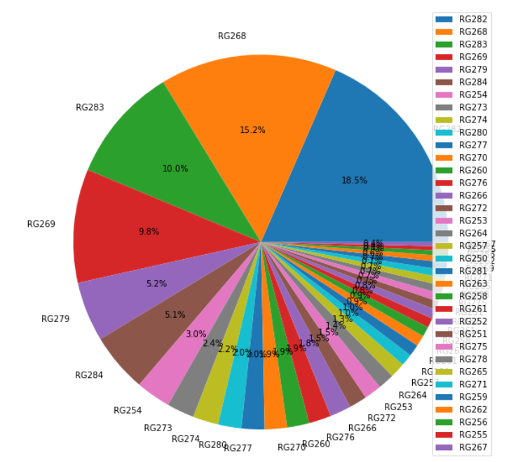
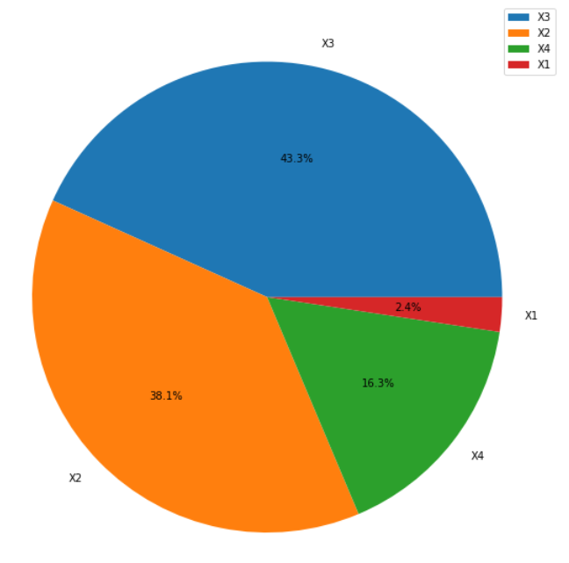
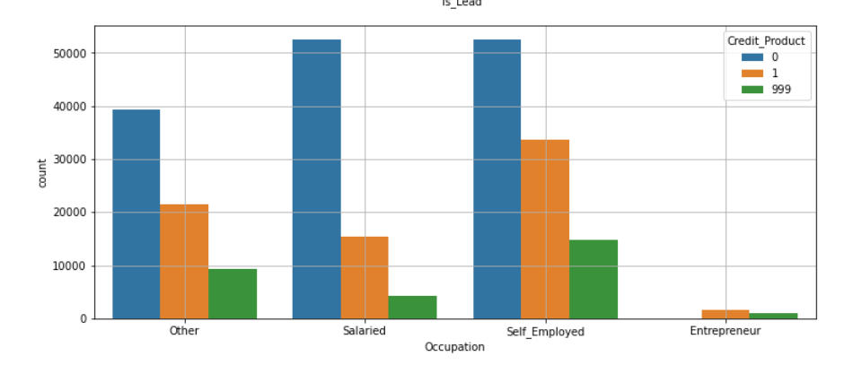
Analysis
Over 50% of the leads are from 4 out of the 35 region codes (encoded)
Over 80% of the leads were acquired through 2 of 4 acquisition channels (encoded)
Clients are most likely to be leads if they are self-employed

Slide 8
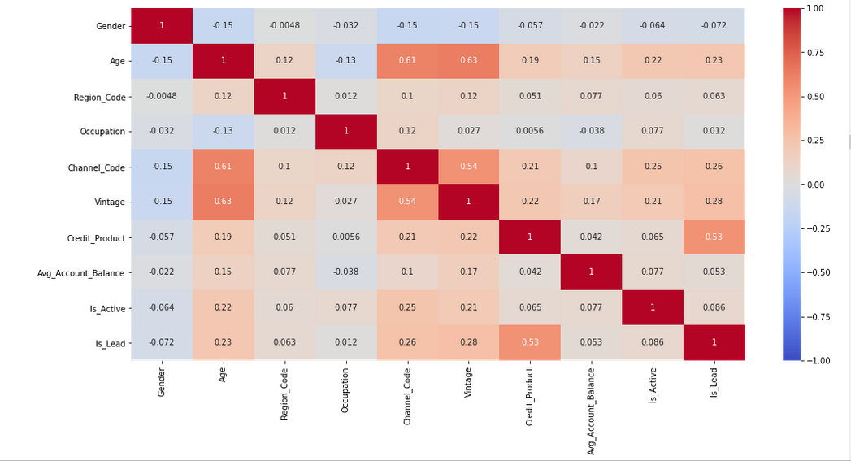
Analysis
The data feature most correlated with being a lead is whether the client already has a credit product
That column also happens to have had many blanks; further data retrieval is necessary
Project Brief
Machine Learning
Conclusions
Analysis

Slide 9
Machine Learning Steps
Machine Learning Pipeline
Data Collection
Data Cleaning
Data Analysis
Model Training
Model Optimizing
Model Evaluation
Project Brief
Machine Learning
Conclusions
Analysis

Slide 10
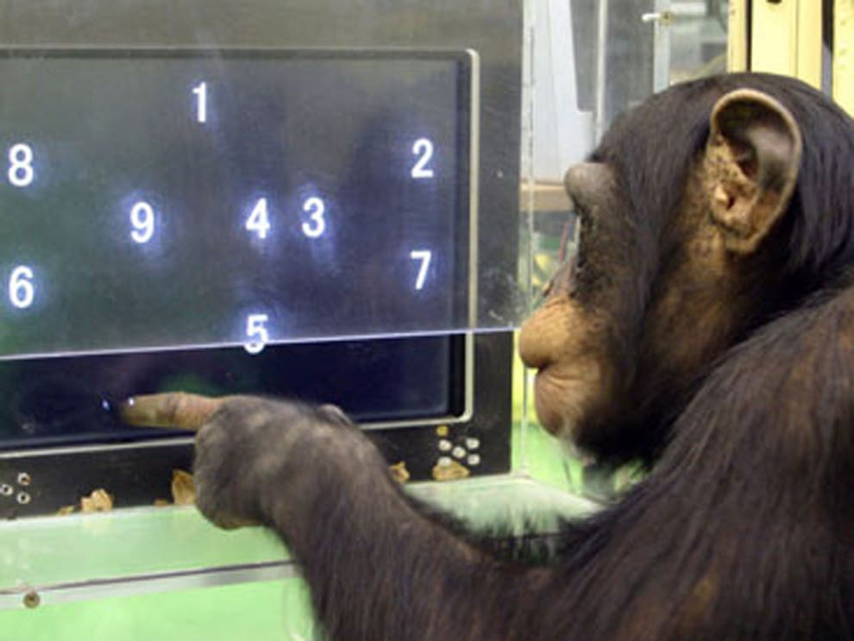
The Da Vinchimp Code
The author, coding
Project Brief
Machine Learning
Conclusions
Analysis

Slide 11
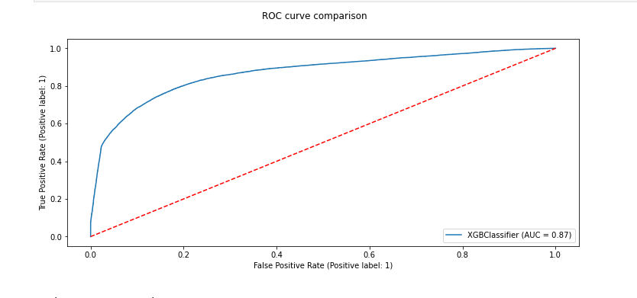
Machine Learning
Classifier | Accuracy | CV Accuracy | Recall | Precision | F1 Score
DecisionTree | 0.785349 | 0.785492 | 0.545492 | 0.570338 | 0.557638
RandomForest | 0.837318 | 0.851826 | 0.660841 | 0.645479 | 0.65307
Naive Bayes | 0.586143 | 0.627551 | 0.343388 | 0.816349 | 0.483428
KNeighbours | 0.740035 | 0.835568 | 0.466706 | 0.672156 | 0.5509
SVM | 0.798291 | 0.856649 | 0.565078 | 0.649854 | 0.604508
LogisticRegression | 0.775766 | 0.850605 | 0.520755 | 0.686567 | 0.592275
ExtraTreesClassifier | 0.82458 | 0.836056 | 0.632055 | 0.623435 | 0.627715
AdaBoostClassifier | 0.831743 | 0.856079 | 0.631143 | 0.69952 | 0.663575
GradientBoostingClassifier | 0.834632 | 0.860983 | 0.632158 | 0.724395 | 0.675141
XGB | 0.85791 | 0.856832 | 0.745149 | 0.609453 | 0.670504
Project Brief
Machine Learning
Conclusions
Analysis

Slide 12
Hyper-Parameter Tuning
XGBoost Before Hyper-parameter Tuning:
Classifier | Accuracy | Recall | Precision | F1 Score
XGB | 0.858378 | 0.749787 | 0.604820 | 0.669547
Recall is the metric to focus on.
It is a measure of the leads we falsely predict as non-leads.
The higher, the better!
XGBoost After Hyper-parameter Tuning: Significant Recall improvement.
Classifier | Accuracy | Recall | Precision | F1 Score
XGB | 0.861308 | 0.824966 | 0.527191 | 0.643290
Project Brief
Machine Learning
Conclusions
Analysis

Slide 13
Conclusions
Focus promotions on:
Highest client-content regions
Highest lead-content regions
Highest lead-content acquisition channels
Sub-segment via surveys to further understand the occupational categories
Project Brief
Machine Learning
Conclusions
Analysis

Slide 14
Conclusions
Conclusions
Cater more products to business owners to get more leads from this category
Improve data availability for credit product column
Survey the clientele to gauge interest and needs in various products in the various demographics
Next step - Employ deep learning, neural networks for further accuracy
Project Brief
Machine Learning
Conclusions
Analysis

Slide 15


Python
SQL
PowerBI
Ape vlog
and more
Full project code will be available on my GitHub: https://github.com/YamCooper
yamcooper@outlook.com
LinkedIn: https://ca.linkedin.com/in/yam-cooper-1599108a
“How to
escape
the zoo?”
The author, posting on StackOverflow

